Slide 1
Willowbank Quarry
Community Liaison Group Update Date
February 2024

Slide 2
Willowbank Quarry CLG Update
The following slides are an outline of the physical works that we intend to begin in February, following receiving approval from councils of the Quarry Management Plan.
The work we are undertaking will be:
Building the visual bund adjacent to the main access road to the quarry. The material to form the bunds will be excavated overburden from within the quarry, and will be trucked to the bund area. Silt and sediment controls will be in place while bunds are being built.
2. Preliminary work will begin on widening the access road to the Fill Site and the back of the farm
Shane Hagai, Quarry Manager, has provided the schedule in some detail which is on the last two slides
Upgrading the entrance way and intersection at the quarry entrance as required by the consent – work may start in late February but it is more likely that it will start in early March
It is planned to hold our next CLG meeting in early March, so we will be able to view the work that has been undertaken.
All the work indicated are activities that we are permitted to undertake and were confirmed with council prior to work starting. Sales of materials from the quarry will not be occurring.

Slide 3
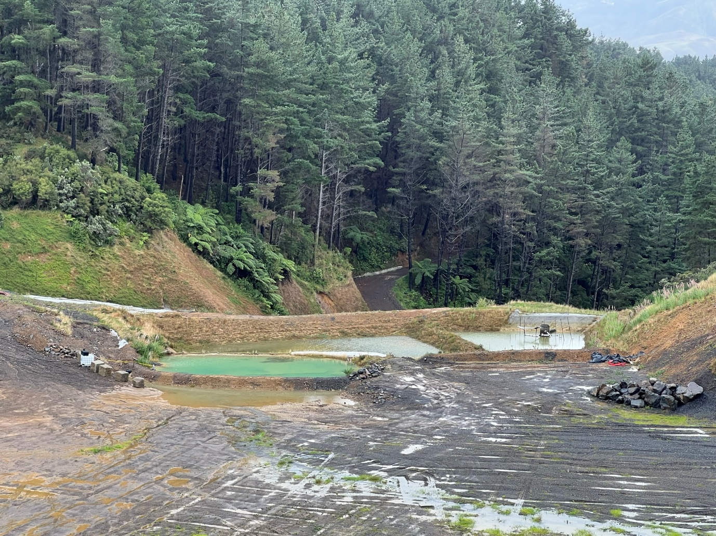
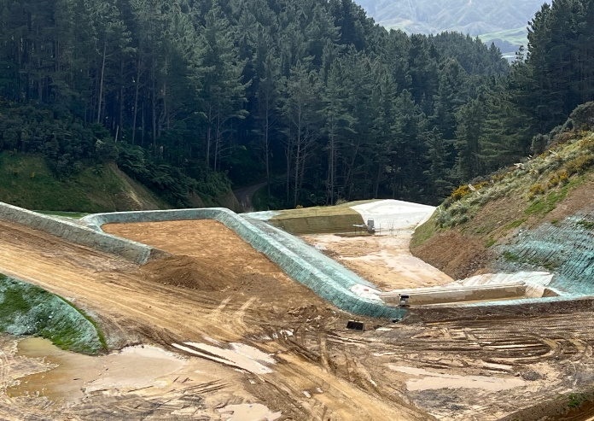
Willowbank Quarry CLG Update
Week 0 – 7th Feb
Pre-works:
Import 13t excavator and perform Certified Safe inspection prior to works commencing.
Install signage along Quarry Access Road for vehicle passing bays.
Perform Contractor Site induction for both Quarry and Construction works areas (noting different operational times).
Week 1 – 12th Feb
Visual Bund:
Track 13t excavator into the site for Erosion and Sediment controls.
Silt fence installation.
2 x DEB constructions, inc installation of 2 x rain activated Floc treatment stations.
Positive earth bund/dirty water drains installation.
Removal of farm troughs and irrigation pipes.
Quarry Works:
Track 36t excavator into Overburden removal area.
Create access track and load out area for overburden removal.
87t excavator to arrive for Certified Safe inspection and bulk loading.
Dump trucks and watercart to arrive for Certified Safe inspections.

Slide 4
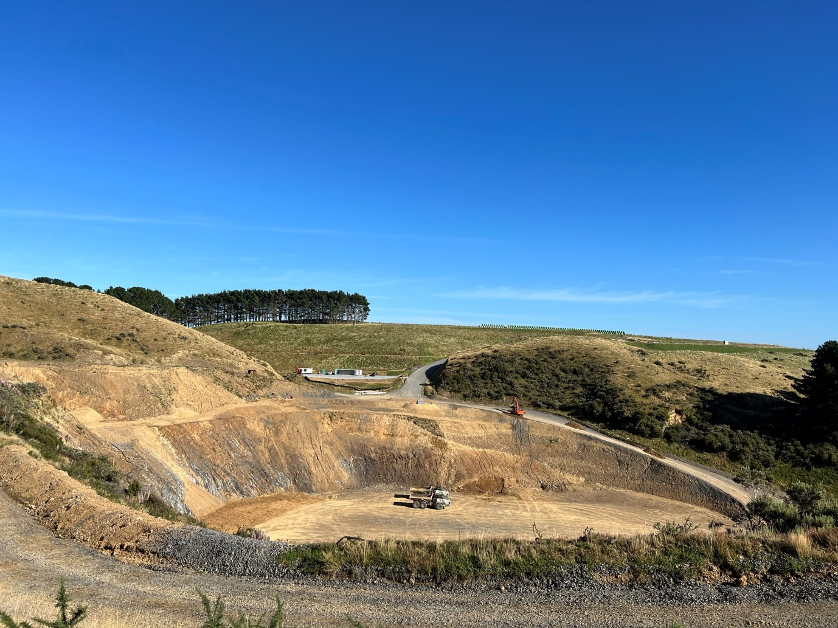
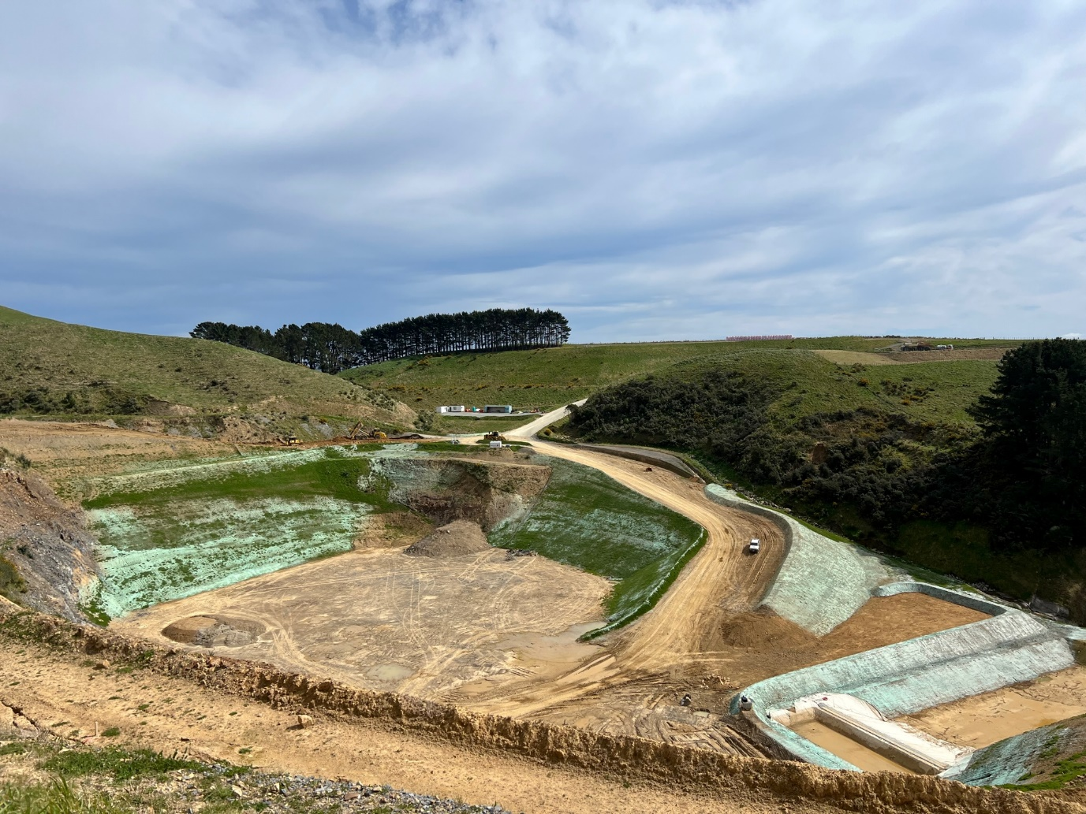
Willowbank Quarry CLG Update
Week 2 – 19th Feb
Visual Bund:
Install access road for dump truck access to furthest point of bund build.
Strip and Stockpile topsoil within paddock at bund location.
Begin bulk imports of overburden to build bund.
Dust suppression using watercarts.
Quarry Works:
Extract Overburden using 87t excavator.
Dust suppression using watercart.
Week 3 – 26th Feb
Visual Bund:
Continue building Visual Bund, trim to designed height and shape.
Using local stockpile, topsoil any completed bund areas, shape, hay mulch and hydroseed.
Remove a section of trees as identified for bund construction.
Dust suppression using watercarts.
Quarry Works:
Continue overburden extraction for visual bund build.
Begin Fill Site access road widening.
Dust suppression using watercarts.
Week 4 – 4th March
Continues as per Week 3

